Slide 1
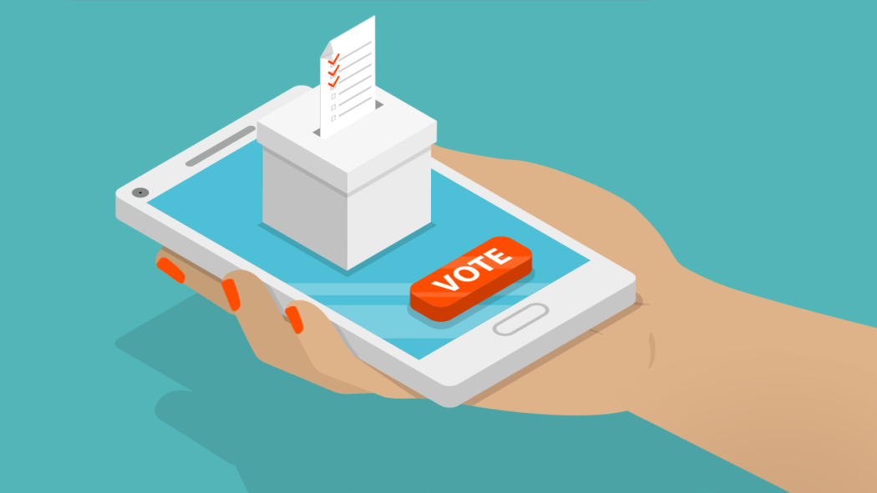
2020 Online Voting App

Slide 2
How does it work?
Avoid long lines and crowded polls and vote right from your phone
Vote from anywhere at any time in seconds

Slide 3
What will it include?
Clear information on each candidate including but not limited to their beliefs and laws they are for or against.
Live debates between each candidate before the election.
Live news and twitter updates on important topics that YOU personally care about.

Slide 4
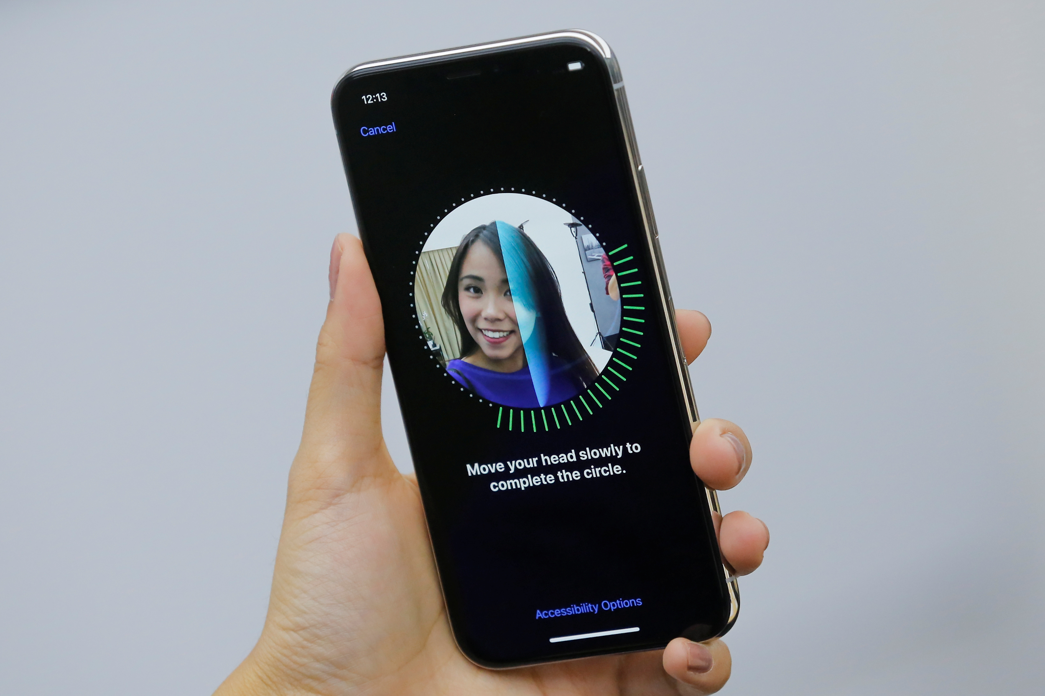
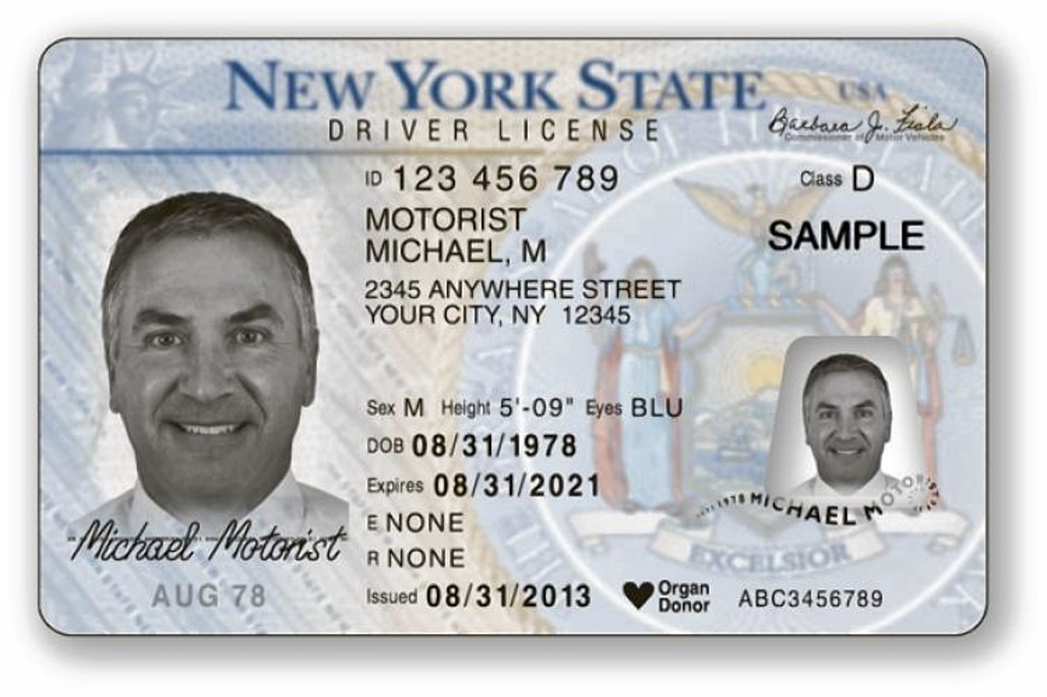
How will we verify your
identity?

Slide 5
Is it safe?
Each voting process is recorded through your phone’s camera and saved for extra security.
Safer than voting by mail, which can get lost on its way, arrive too late, or even altered.

Slide 6
Benefits?
Increase the number of young voters.
Allow people who are quarenting to vote.
Stop the spread of Covid-19.
Provide more information about the candidates to the public.

